Slide 1


SRS for invoice management
Name – yashi gayakwad
Subject – system analysis and design
Roll no. –IT- 2k19-74

Slide 2
System requirements specifications for invoice management
Objectives
Existing System
Functional Requirements
Non-Functional Requirements
System Authorization Use Cases
Maintain Client details
Maintain Employee information

Slide 3
Objectives
Maintains a detailed record of the employees such as a total number of hours, type of project, job role, and hourly pay.
Reduce human errors and automatic calculations are done without errors.
Can generate an invoice and detailed report on employee payments.
The automatically generated reports are flexible for the clients to pay to the employees.
Flexible usability for the employees to enter their login and logout hours.
Improves accuracy and timeliness, security.

Slide 4
Existing System:
The client has identified these problems:
Generation of the Invoice is very slow and takes a long time to remit to the employee.
The generation reports took even longer then invoice.
Delay in all the reports due to manual work and there are possible human errors which may cost the client.
Manual work is expensive
Data loss can happen easily
There is no way to find a duplicate entry of data.

Slide 5
Functional Requirements:
Maintain company information
Taking up the project
Maintain project person information
Maintain Employee information
Maintain project data
Maintain client data
Enter Time for Employee
Generate Invoice
Generate Reports

Slide 6
Non-Functional Requirements
Usability
Availability
Operations
Legal

Slide 7
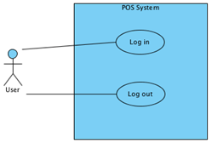
System Authorization Use Cases
1 Log In
2 Log Out

Slide 8
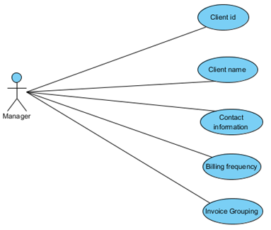
Maintain Client details
Client data

Slide 9
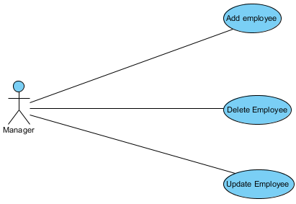
Maintain Employee information
Add employee
Delete employee
Update employee

Slide 10
Thank you!

